Slide 1
CEG5304 / EE6934 (PT2)
Lecture 7:
Deep Generative Models

Slide 2
Once Again Welcome to CEG5304/EE6934!
(Advanced?) Topics on the “new” and “advanced” stuffs of Deep learning: generative models, reinforcement learning, graph neural networks, Bayesian neural network, video and 3D understanding, few-shot and transfer learning, under-explored tasks.
In-person lectures, recording will be available at the end of each class for revision (except the recordings of guest lectures).
Be assured: no materials from these topics will be tested.
Office hour: Prior appointment is much appreciated ☺
Office @ E4-05-36

Slide 3



Background of Myself and Course
Video and time-series analysis.
Transfer learning for efficiency and application.
Combining with LLVM and AIOT devices.
yc.xu@nus.edu.sg
For the second part: explore, introductory, and enjoy (hopefully).
Understanding the development is more important then remembering the techniques.
No computation, less in-depth details.
Analyze and think: what is next in deep learning?

Slide 4
Assessment and Grading
One Continuous Assessments for Part 2, different for CEG5304 and EE6934.
30%. CA2: (15 Mar 24’ – 19 Apr 2024 1800 SGT).
Deadlines are strict. Late submission will be deducted 10 points (out of 100) for every 24 hours.
A task of exploration.
NO plagiarism is allowed. ZERO mark will be given to anyone found plagiarizing and a formal report will be handed for further investigation!

Slide 5
Assessment and Grading
Final: 40%. Different for CEG5304/EE6934:
F2F-computer-based exam. Format to be announced in Canvas.
Details on ExamSoft to be announced and briefed later.

Slide 6
Generative Models: The Basic
Density and Energy Models

Slide 7
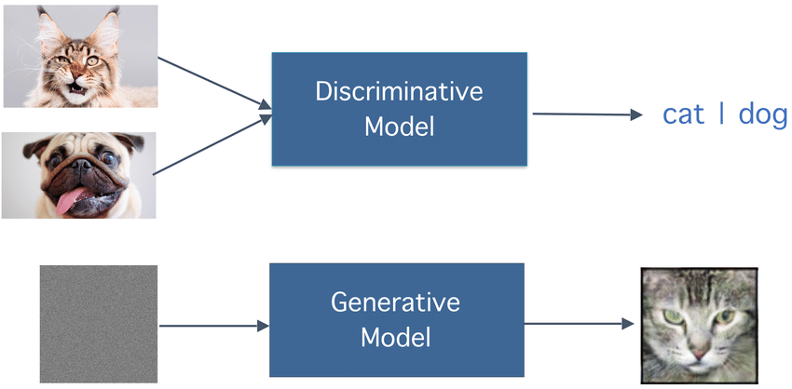
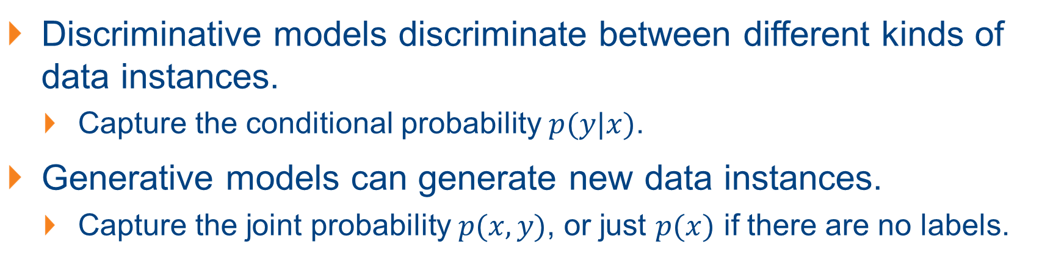
First – What is a Generative Model?
Quick recap: we are more familiar with discriminative models.
Discriminative models discriminate between different kinds of data instances.
Capture the conditional probability $p(y|x)$.
Generative models can generate new data instances.
Capture the joint probability $p(x, y)$, or just $p(x)$ if there are no labels.

Slide 8
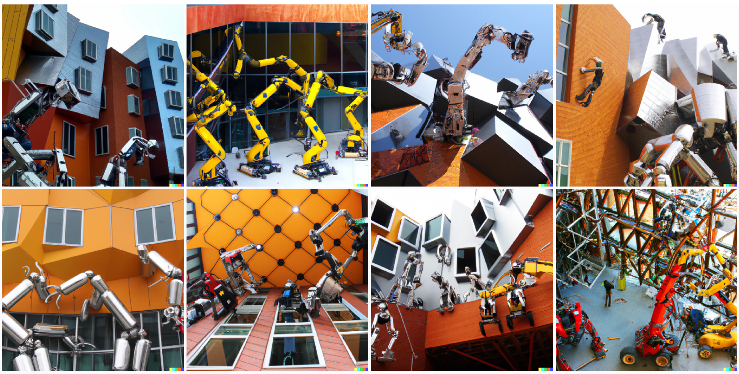
An Example Generative Model: DALL-E-2
A photo of a group of robots building the Stata Center

Slide 9
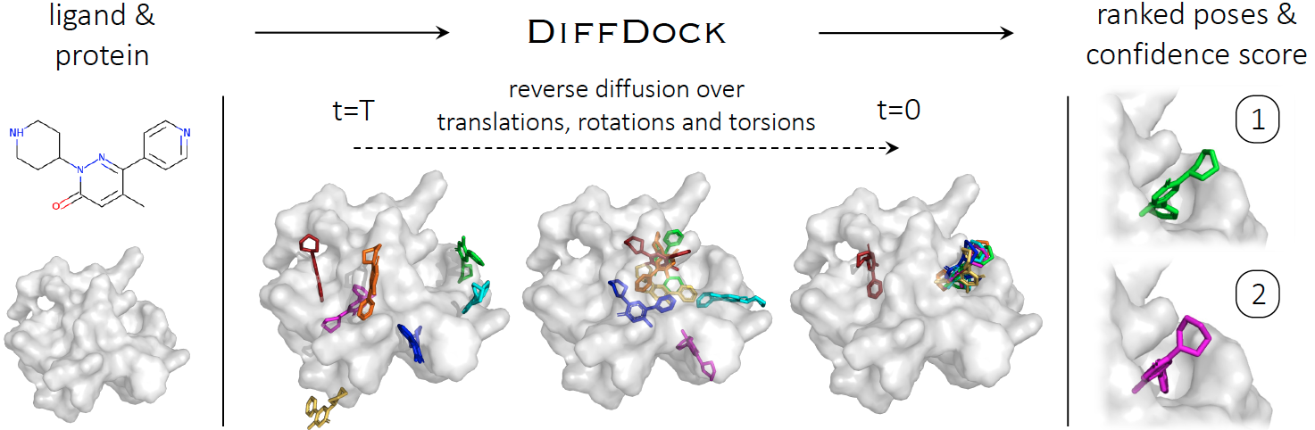
Generative Models in Real-World Applications
DiffDock, method for molecular docking (predicting the binding structure of a small molecule ligand to a protein drug design):

Slide 10
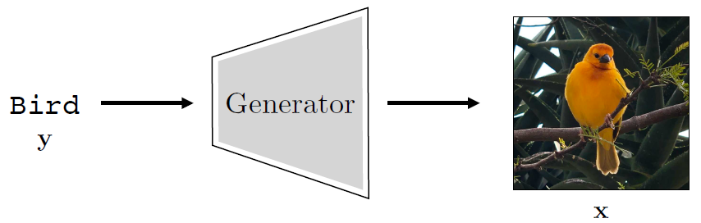
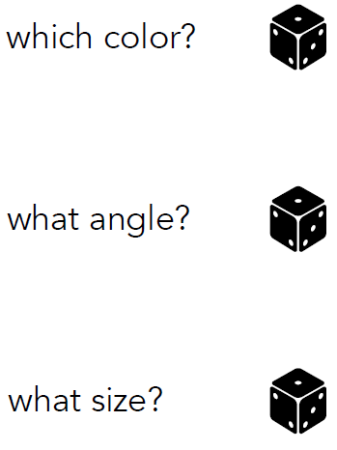
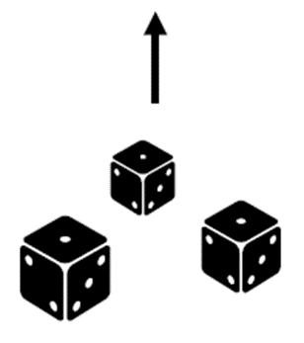
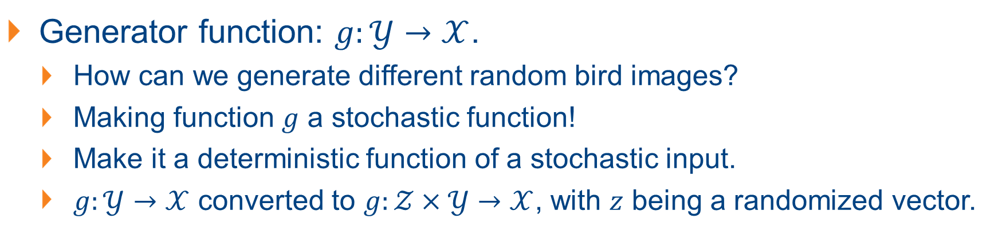

A Simple Generative Model
$$g$$
Generator function: $g:𝒴→𝒳$.
How can we generate different random bird images?
Making function $g$ a stochastic function!
Make it a deterministic function of a stochastic input.
$g:𝒴→𝒳$ converted to $g:𝒵×𝒴→𝒳$, with $z$ being a randomized vector.

Slide 11
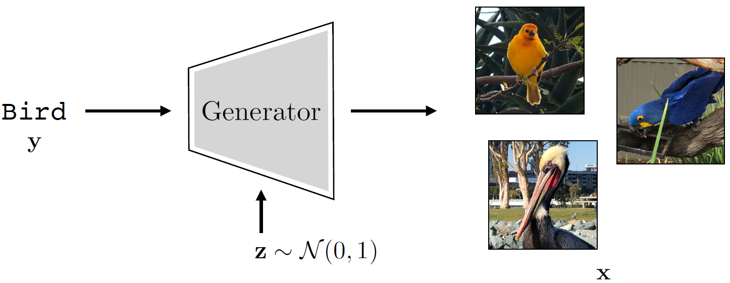
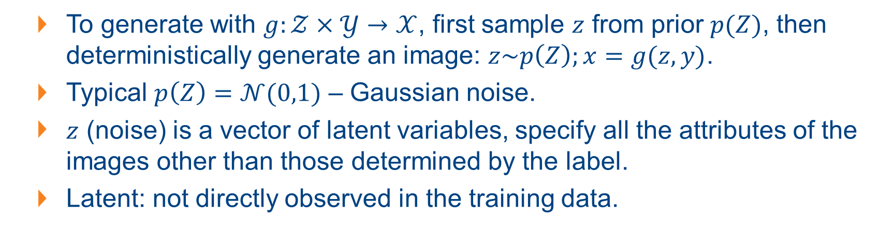
A Simple Generative Model
To generate with $g:𝒵×𝒴→𝒳$, first sample $z$ from prior $p(Z)$, then deterministically generate an image: $z\sim p\left(Z\right);x=g(z,y)$.
Typical $p\left(Z\right)=𝒩(0,1)$ – Gaussian noise.
$z$ (noise) is a vector of latent variables, specify all the attributes of the images other than those determined by the label.
Latent: not directly observed in the training data.
Notes:
Latent: 潜在的
Different dimensions of z specify different attributes, such as the size, color, pose, background, and so on; everything necessary to fully determine the output image.

Slide 12
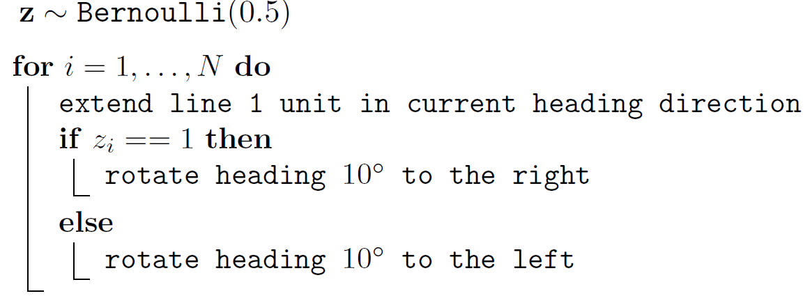
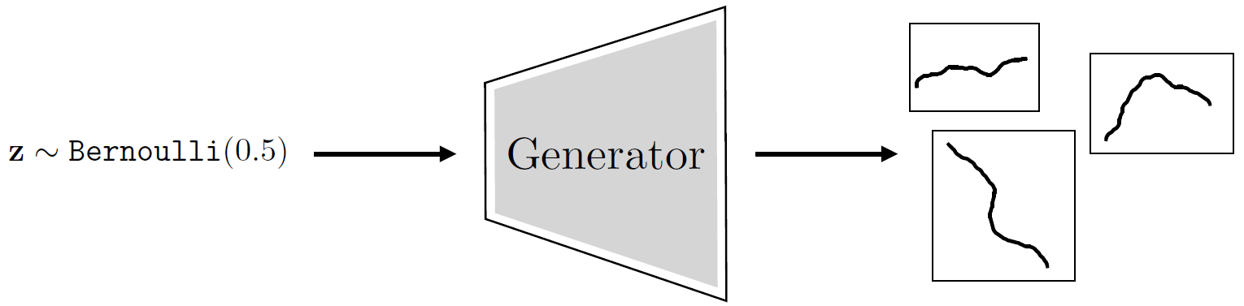
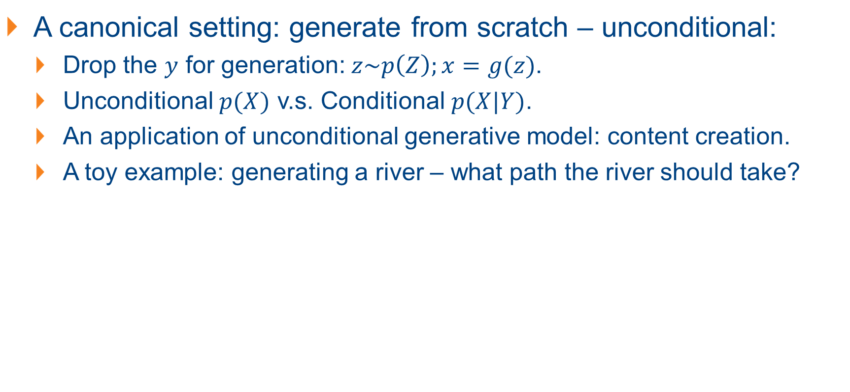
Unconditional Generative Models
A canonical setting: generate from scratch – unconditional:
Drop the $y$ for generation: $z\sim p\left(Z\right);x=g(z)$.
Unconditional $p(X)$ v.s. Conditional $p(X|Y)$.
An application of unconditional generative model: content creation.
A toy example: generating a river – what path the river should take?
Notes:
An unconditional generative model because it is model of the unconditional distribution p(X).
$z \sim Bernoulli (0.5)$ is equivalent to the process of coin flips

Slide 13
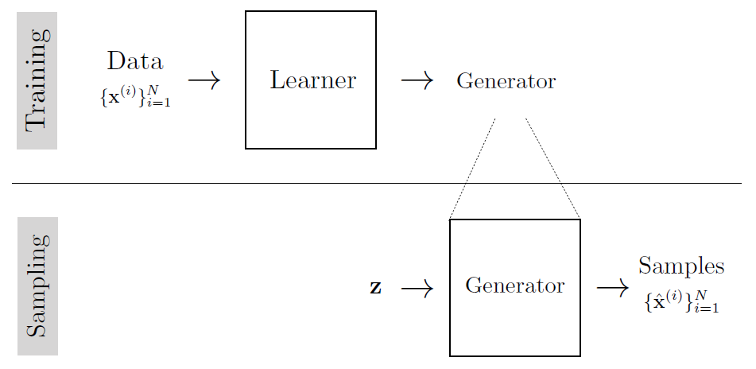
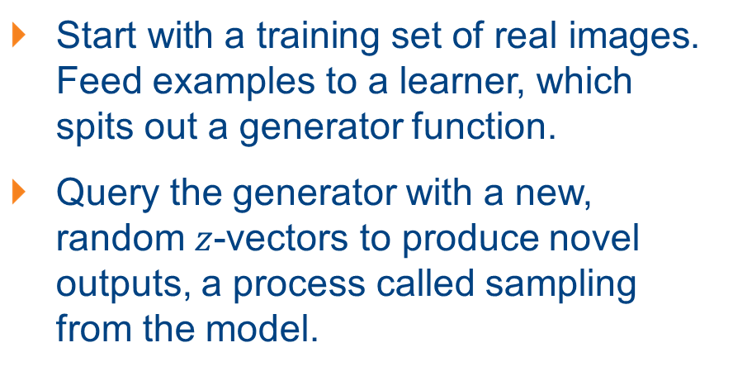
Learning Generative Models: in General
Start with a training set of real images. Feed examples to a learner, which spits out a generator function.
Query the generator with a new, random $z$-vectors to produce novel outputs, a process called sampling from the model.
Objective of generative modeling:
A generator that produces synthetic data that looks like the real data.
Synthetic data matches the real data in terms of certain marginal statistics, e.g., mean color, color variance, edge statistics.
Synthetic data has high probability under a density model fit to real data.

Slide 14
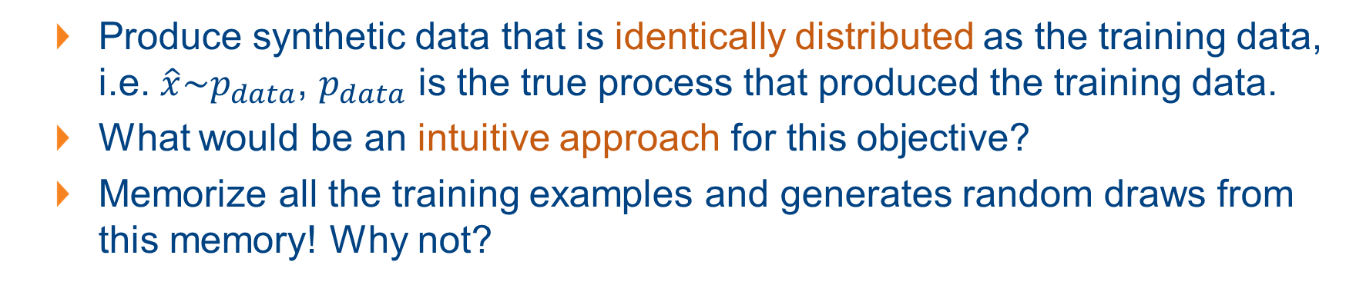
Learning Generative Models: in General
Produce synthetic data that is identically distributed as the training data, i.e. $\hat{x}\sim p_{data}$, $p_{data}$ is the true process that produced the training data.
What would be an intuitive approach for this objective?
Memorize all the training examples and generates random draws from this memory! Why not?
Notes:
Indeed, memorized training samples perfectly satisfy the goal of making synthetic data that looks real. A second, sometimes overlooked, property of a good generative model is that it be a simple, or smooth, function, so that it generalizes to producing synthetic samples that look like the training data but are not identical to it. A generator that only regurgitates the training data is overfit in the same way a classifier that memorizes the training data is overfit. In both cases, the true goal is to fit the training data and to do so with a function that generalizes.

Slide 15
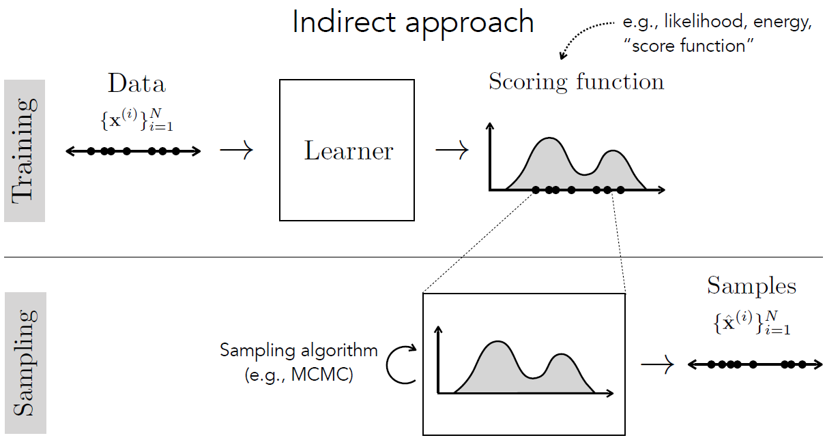
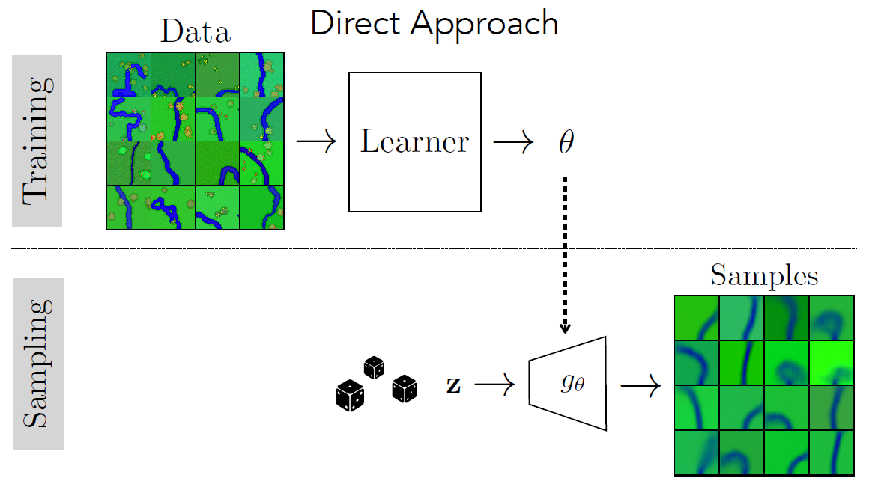
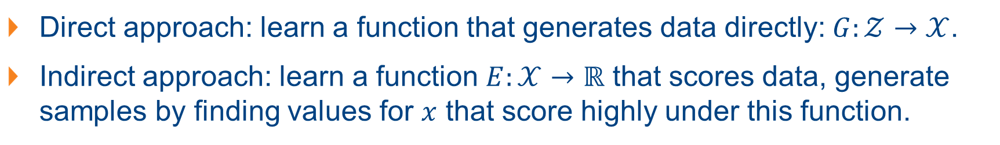
Learning Data Generators: The Approaches
Direct approach: learn a function that generates data directly: $G:𝒵→𝒳$.
Indirect approach: learn a function $E:𝒳→ℝ$ that scores data, generate samples by finding values for $x$ that score highly under this function.
Notes:
The first approach from the perspective of statistical image models, where synthetic textures were made that had the same filter response statistics as a real training example. This approach works well when we only want to match certain properties of the training data. The second approach is better when we want to produce synthetic data that matches all statistics of the training examples.
The direct approach only became popular recently, with models like generative adversarial networks (GANs) and diffusion models.

Slide 16
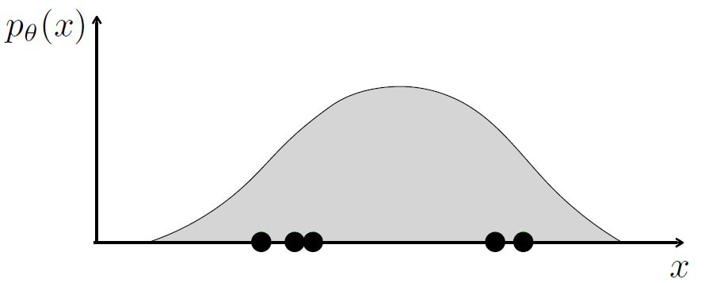
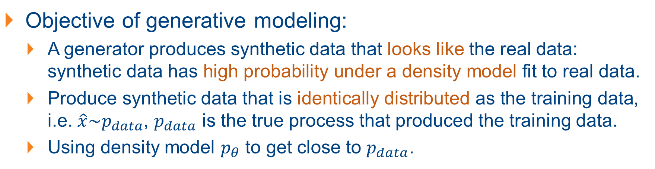
Learning Generative Models via Density Models
Objective of generative modeling:
A generator produces synthetic data that looks like the real data: synthetic data has high probability under a density model fit to real data.
Produce synthetic data that is identically distributed as the training data, i.e. $\hat{x}\sim p_{data}$, $p_{data}$ is the true process that produced the training data.
Using density model $p_{θ}$ to get close to $p_{data}$.

Slide 17
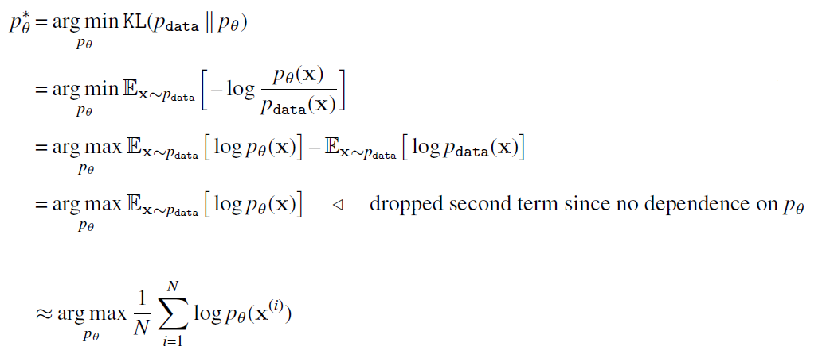
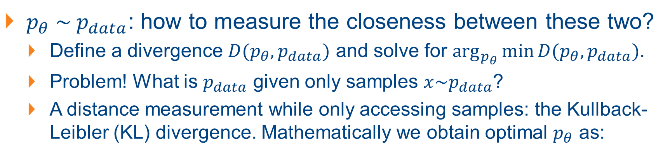
Learning Generative Models via Density Models
$p_{θ} \sim p_{data}$: how to measure the closeness between these two?
Define a divergence $D(p_{θ}, p_{data})$ and solve for $\arg_{p_{θ}}{\min{D(p_{θ}, p_{data})}}$.
Problem! What is $p_{data}$ given only samples $x\sim p_{data}$?
A distance measurement while only accessing samples: the Kullback-Leibler (KL) divergence. Mathematically we obtain optimal $p_{θ}$ as:
Eqn (A)

Slide 18
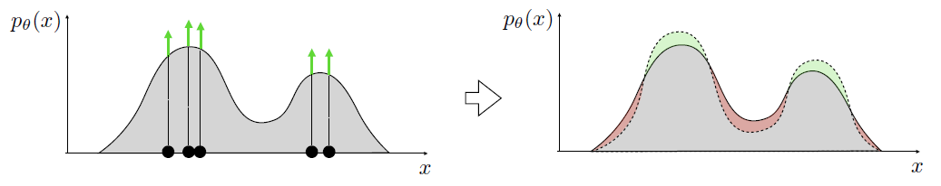
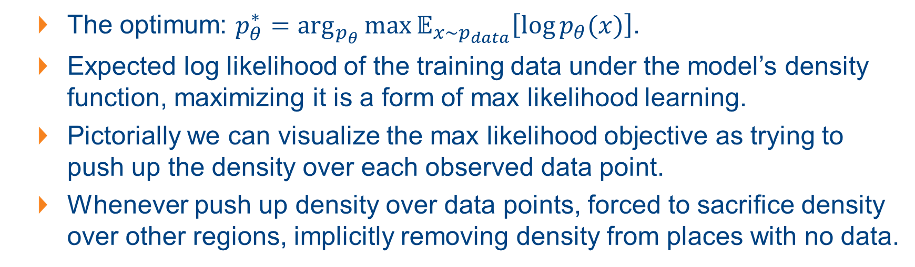
Learning Generative Models via Density Models
The optimum: $p_{θ}^{∗}=\arg_{p_{θ}}{\max{𝔼_{x\sim p_{data}}\left[\log{p_{θ}(x)}\right]}}$.
Expected log likelihood of the training data under the model’s density function, maximizing it is a form of max likelihood learning.
Pictorially we can visualize the max likelihood objective as trying to push up the density over each observed data point.
Whenever push up density over data points, forced to sacrifice density over other regions, implicitly removing density from places with no data.

Slide 19
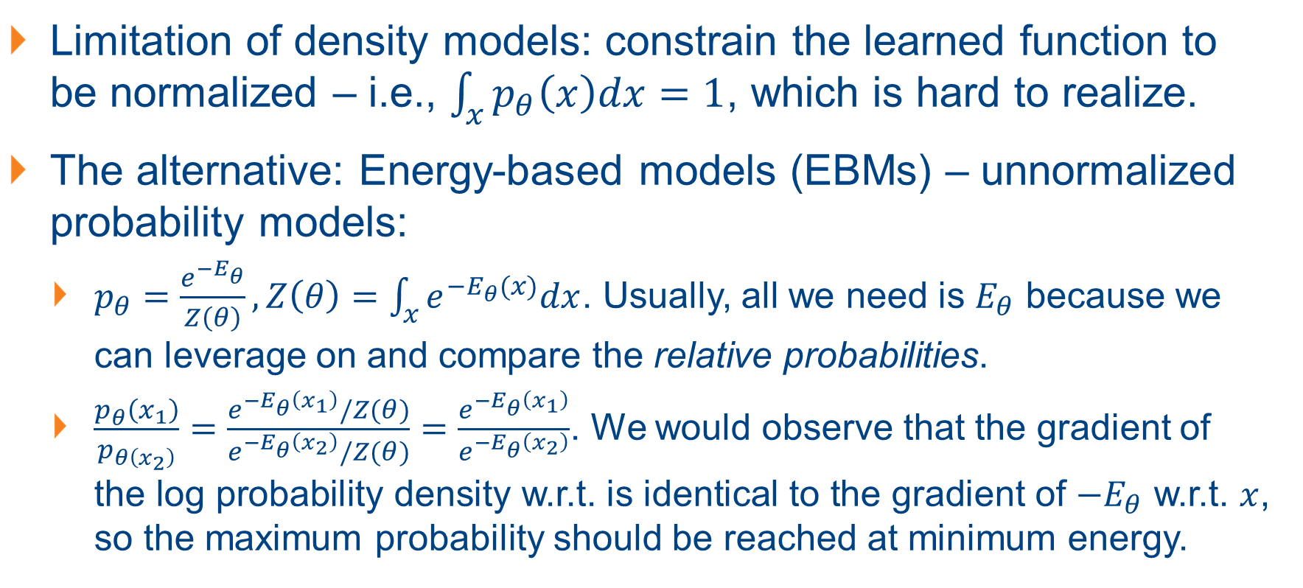
Generative Modelling via Energy-Based Models
Limitation of density models: constrain the learned function to be normalized – i.e., $\int_{x}{p_{θ}\left(x\right)dx=1}$, which is hard to realize.
The alternative: Energy-based models (EBMs) – unnormalized probability models:
$p_{θ}=\frac{e^{−E_{θ}}}{Z\left(θ\right)}, Z\left(θ\right)=\int_{x}{e^{−E_{θ}(x)}dx}$. Usually, all we need is $E_{θ}$ because we can leverage on and compare the relative probabilities.
$\frac{p_{θ}\left(x_{1}\right)}{p_{θ\left(x_{2}\right)}}=\frac{e^{−E_{θ}\left(x_{1}\right)}/Z(θ)}{e^{−E_{θ}\left(x_{2}\right)}/Z(θ)}=\frac{e^{−E_{θ}\left(x_{1}\right)}}{e^{−E_{θ}\left(x_{2}\right)}}$. We would observe that the gradient of the log probability density w.r.t. is identical to the gradient of $−E_{θ}$ w.r.t. $x$, so the maximum probability should be reached at minimum energy.
Notes:
$p_{θ}$: Boltzmann or Gibbs distribution.
They are however insufficient for applications communicating probabilities is important for either interpretability or for interfacing with downstream systems that require knowing true probabilities.
A case where a density model might be preferable over an energy model is a medical imaging system that needs to communicate to doctors the likelihood that a patient has cancer.

Slide 20
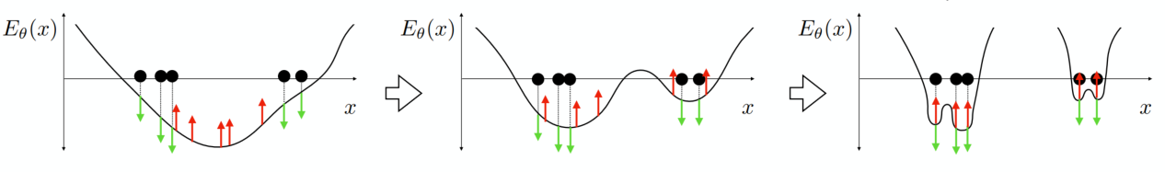
Learning the Parameters of Energy-Based Models
Energy models not normalized – add a negative term to push up energy where there are no data in addition to the positive term of pushing down energy where the data is observed.
Contrastive divergence:
Each iteration, decrease the energy assigned to samples from the data (positive, green) and increase the energy assigned to samples from the model (i.e., samples from the energy model itself; negative, red).

Slide 21
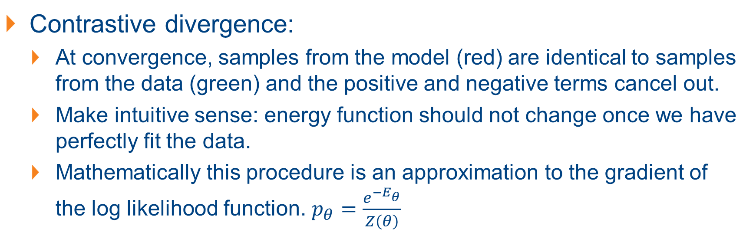
Learning the Parameters of EBMs
Contrastive divergence:
At convergence, samples from the model (red) are identical to samples from the data (green) and the positive and negative terms cancel out.
Make intuitive sense: energy function should not change once we have perfectly fit the data.
Mathematically this procedure is an approximation to the gradient of the log likelihood function. $p_{θ}=\frac{e^{−E_{θ}}}{Z\left(θ\right)}$

Slide 22
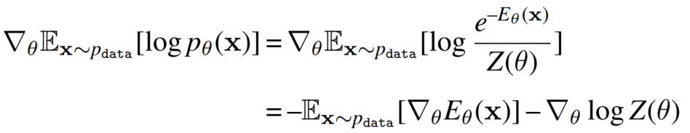
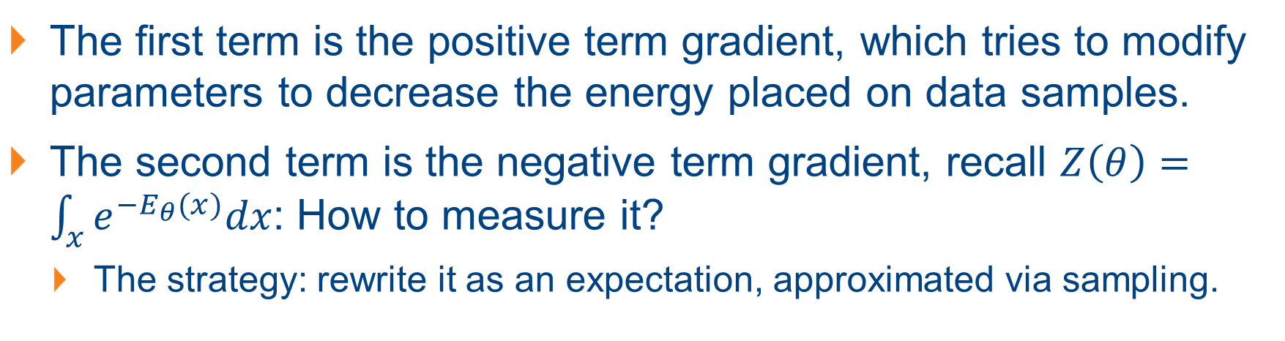
Learning the Parameters of EBMs
The first term is the positive term gradient, which tries to modify parameters to decrease the energy placed on data samples.
The second term is the negative term gradient, recall $Z\left(θ\right)=\int_{x}{e^{−E_{θ}(x)}dx}$: How to measure it?
The strategy: rewrite it as an expectation, approximated via sampling.

Slide 23
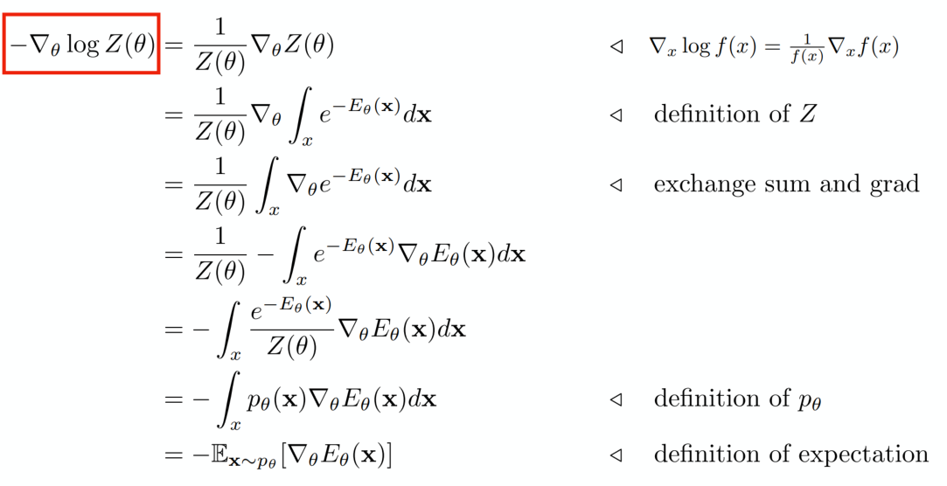
Learning the Parameters of EBMs: the Derivation
Notes:
From chain rule: $∇_{x}\log{f\left(x\right)}=\frac{1}{f\left(x\right)}∇_{x}f(x)$

Slide 24
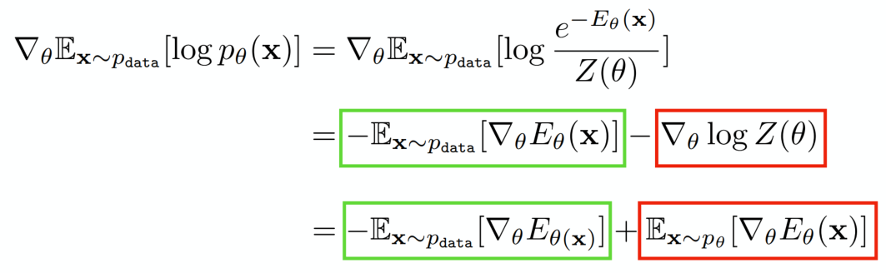
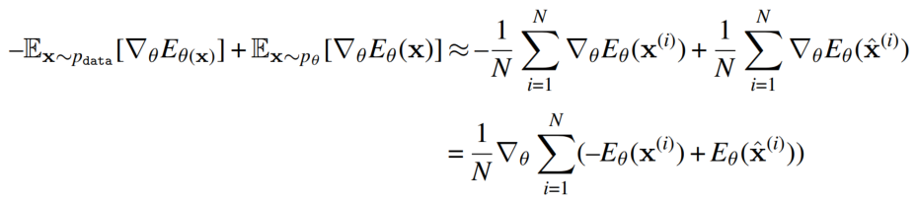
Learning the Parameters of EBMs: the Derivation
Both expectations can be approximated via sampling. By defining $x^{(i)}∼p_{data}$ and ${\hat{x}}^{(i)}∼p_{θ}$, and taking $N$ samples:
Notes:
The last line should make clear the intuition: we establish a contrast between data samples and current model samples, then update the model to decrease this contrast, bringing the model closer to the data.
Once x(i) and x^(i) are identically distributed, this gradient will be zero: we have perfectly fit the data and no further updates should be taken.
Under our formalization, the contrastive divergence is an optimizer; it’s an optimizer specifically built formax likelihood objectives over energy functions.
Contrastive divergence tells us how to approximate the gradient of the likelihood function, which can then be plugged into any gradient descent method.

Slide 25
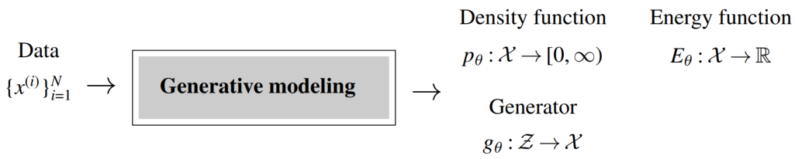
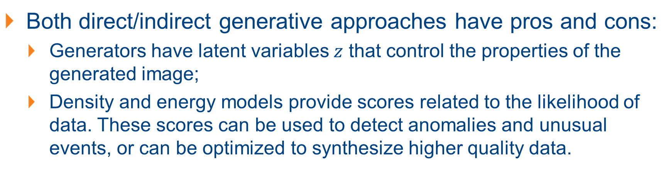
Comparing Different Kinds of Generative Models
Both direct/indirect generative approaches have pros and cons:
Generators have latent variables $z$ that control the properties of the generated image;
Density and energy models provide scores related to the likelihood of data. These scores can be used to detect anomalies and unusual events, or can be optimized to synthesize higher quality data.

Slide 26
Generative Models: Useful Density Models
Gaussian and Autoregressive Density Models
Notes:
A case where a density model might be preferable over an energy model is a medical imaging system that needs to communicate to doctors the likelihood that a patient has cancer.

Slide 27
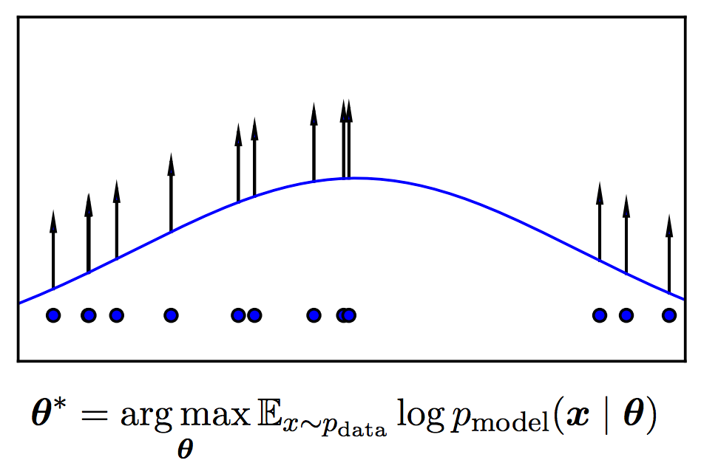
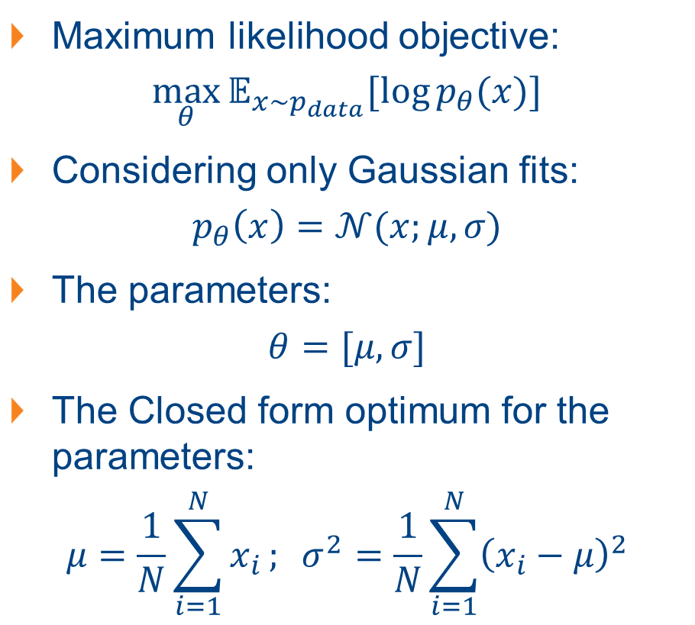
Useful Density Models: Gaussian Density Models
Maximum likelihood objective:
$$\max_{θ}{𝔼_{x\sim p_{data}}[\log{p_{θ}(x)}]}$$
Considering only Gaussian fits:
$$p_{θ}\left(x\right)=𝒩(x;μ,σ)$$
The parameters:
$$θ=[μ,σ]$$
The Closed form optimum for the parameters:
$$μ=\frac{1}{N}\sum_{i=1}^{N}{x_{i}}; σ^{2}=\frac{1}{N}\sum_{i=1}^{N}{{\left(x_{i}−μ\right)}^{2}}$$

Slide 28
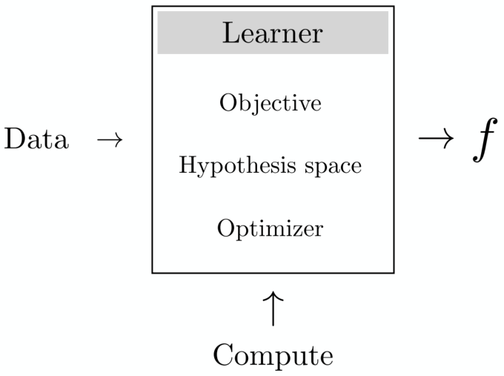
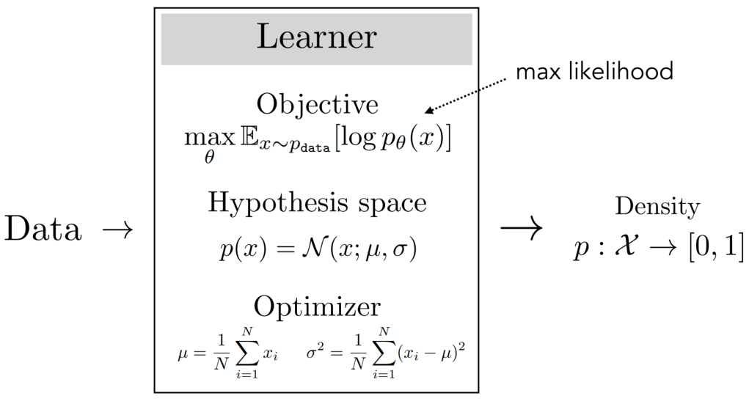
Useful Density Models: Gaussian Density Models

Slide 29

Going Further: the Autoregressive Density Models
Problem with using single Gaussian? Limited and not realistic!
How can we generate images?
Images are built with pixels: if we can generate pixels, we thus generate images!
A relevant strategy from language: we generate a sentence with words – predict the next word given the previous word(s)
Autoregressive models!
Notes:
A recipe for building highly expressive models out of simple ones. There are many such recipes and the one we focus on here is called an autoregressive model.

Slide 30
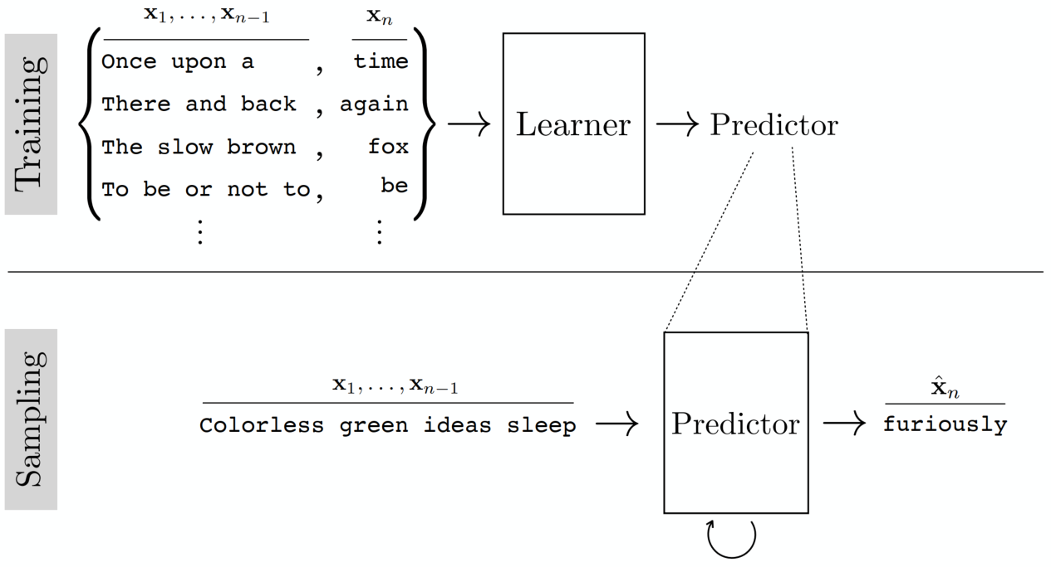
Autoregressive Models: for Sentence Generation

Slide 31
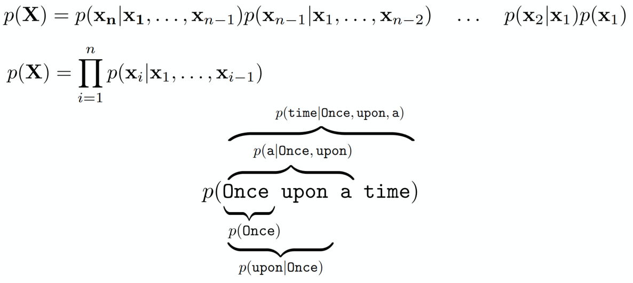
Autoregressive Models: for Sentence Generation
Autoregressive (AR) models forecast future behavior based on past behavior data, where autoregressive modeling uses only past data to predict future behavior. Mathematically:

Slide 32
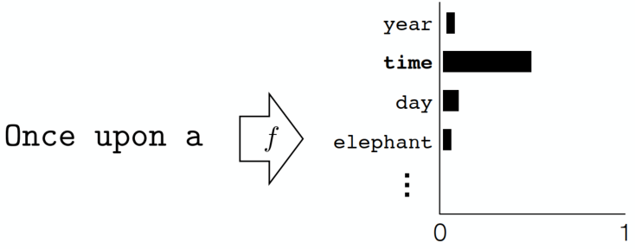
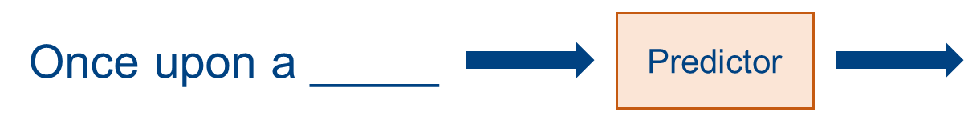
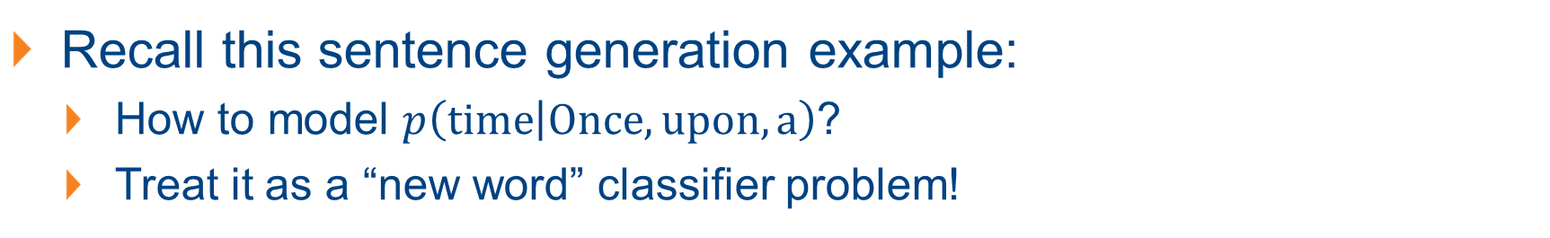
Autoregressive Models: for Sentence Generation
Recall this sentence generation example:
How to model $p\left(time | Once, upon, a\right)$?
Treat it as a “new word” classifier problem!

Slide 33
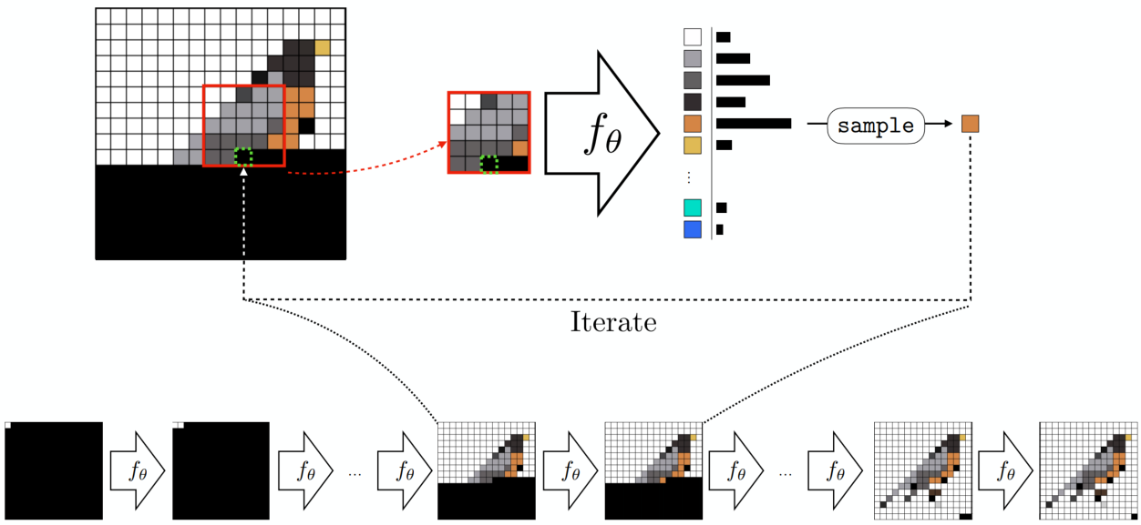
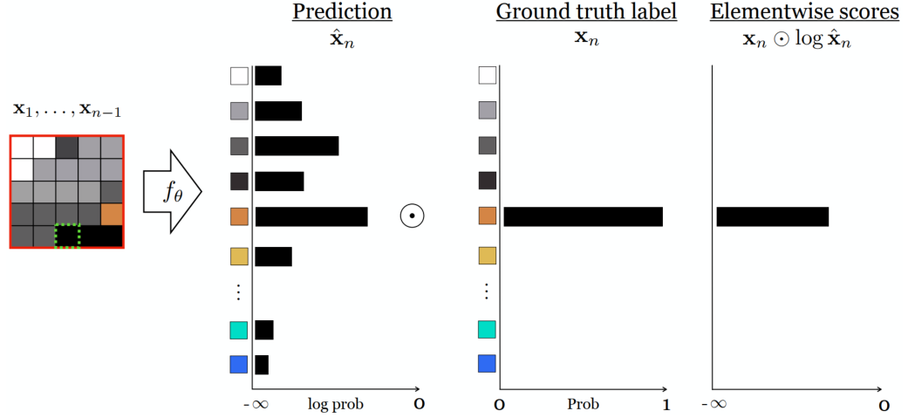
Autoregressive Models: Image Generation
Synthesize an image pixel-by-pixel
Predict each next pixel from the partial image already completed – from the context of the partial image.
Notes:
The red bordered region is the context the prediction is based on. This context could be the entire image synthesized so far or it could be a smaller region, like shown here.
The green bordered pixel is the one we are predicting given this context. In this example, we always predict the bottom-center pixel in the context window.
After making our prediction, we decide what color pixel to add to the image based on that prediction
We show how the cross-entropy loss can be computed in figure 2, Cross-entropy loss $−\sum_{c=1}^{M}{y_{c}\log{(p_{c})}}$.
If we have color images we need to predict three values per-pixel, one for each of the red, green, and blue channels. One way to do this is to predict and sample the values for these three channels in sequence: first predict the red value as a 256-way classification problem, then sample the red value you will use, then predict the green value as a 256-way classification problem, and so on.

Slide 34
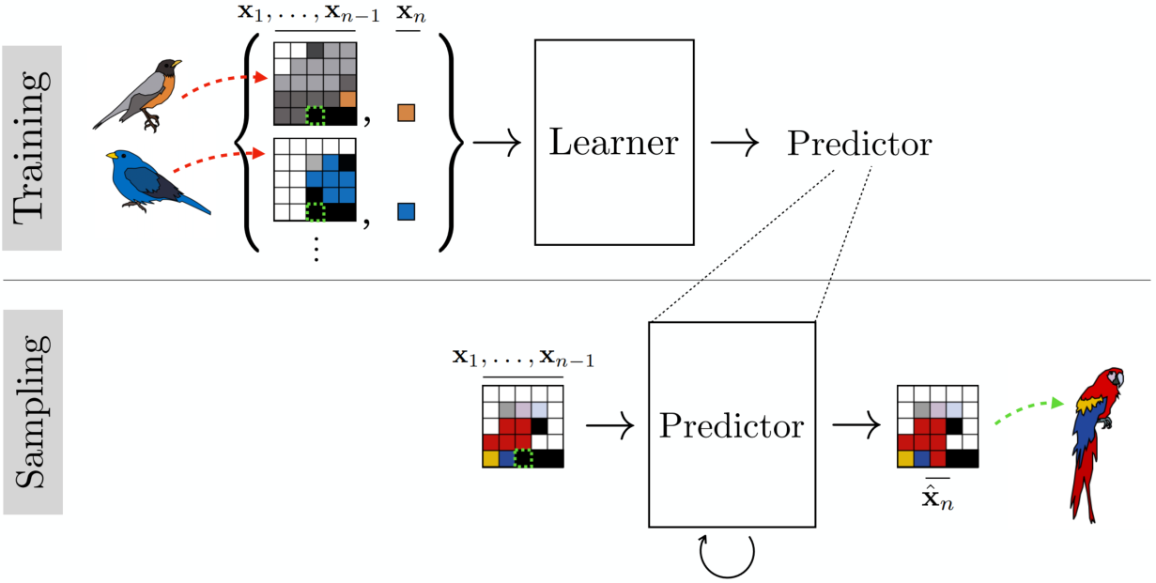
Training Autoregressive Models for Img Generation
Extracting sequences of pixels $\{x_{1}, …, x_{n}\}$ and the corresponding next pixel observed $x_{n}$.
Ancestral Sampling
Notes:
To train an autogressive a model, you just need to extract supervised pairs of desired input-output behavior, as usual.
For an autoregressive model of pixels, that means extracting sequences of pixels x1, …, xn–1 and corresponding observed next pixel xn
Ancestral Sampling: sampling the first pixel from p(x1), then, conditioned on this pixel, sampling the second from p(x2 | x1) an so forth.
Autogressive models do not have latent variables z, which makes them incompatible with applications that involve extracting or manipulating latent variables.

Slide 35
Limitations and Takeaways of Autoregressive Models
Generation process is controlled by a single probability chain:
No latent variable (vanilla autoregressive)!
Best to leverage latent variables to directly control generated samples.
The strategy of breaking a hard generation problem into lots of simple pieces (e.g., pixel prediction) should be preserved.

Slide 36
Generative Models with Latent Variables
Diffusion Models
Generative Adversarial Networks (GANs)
Notes:
A case where a density model might be preferable over an energy model is a medical imaging system that needs to communicate to doctors the likelihood that a patient has cancer.

Slide 37
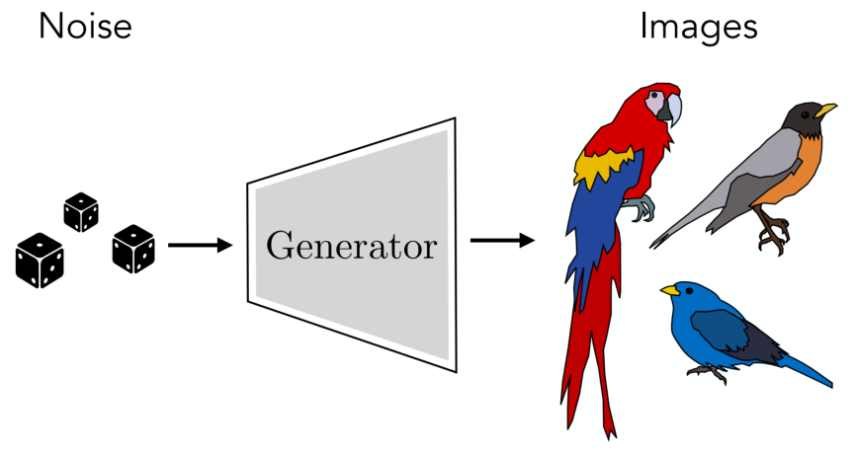
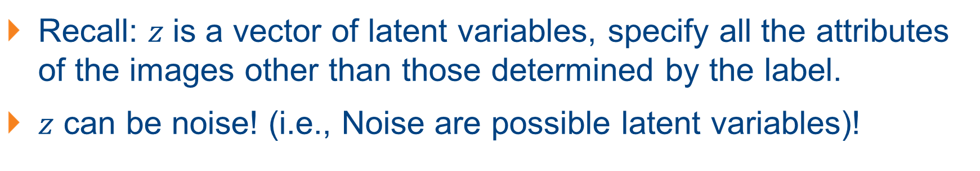
Diffusion Models: Generating with Noise
Recall: 𝑧 is a vector of latent variables, specify all the attributes of the images other than those determined by the label.
$z$ can be noise! (i.e., Noise are possible latent variables)!

Slide 38
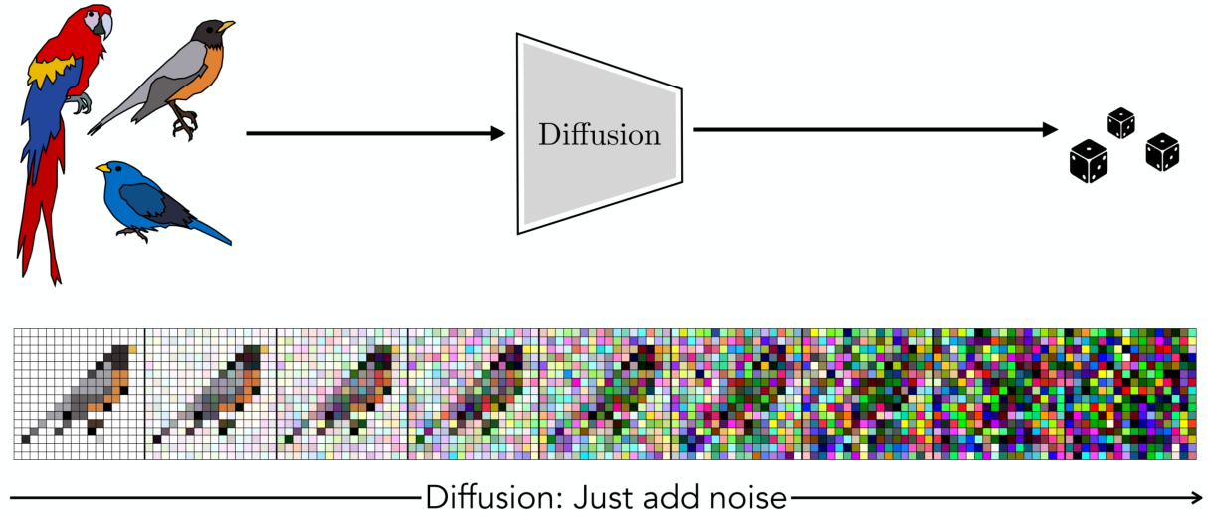
Diffusion Models: Generating with Noise
What noise should be leveraged for the generation process?
Diffusion: Stochastic in nature, process resulting from random motion of molecules.
(Forward) Diffusion process in image generation: from image to noise.
Achieved by adding noise (Gaussian noise) step by step.
Notes:
A Markov chain or Markov process is a stochastic model describing a sequence of possible events in which the probability of each event depends only on the state attained in the previous event.

Slide 39


Diffusion Process and Autoregressive Sequence
An alternative way to understand diffusion process:
Consider what autoregressive models do in the reverse direction;
Starting with complete image, remove pixel-by-pixel – signal corruption.

Slide 40


Diffusion Process: Formulation with Gaussian
Given $x_{0}\sim p_{data}(x)$, a forward diffusion process add small amount of Gaussian noise to $x_{0}$ in $T$ steps, producing noisy samples $x_{1}, …, x_{T}$.
Image $x_{T}$ looks like a pure noise if $T$ is large: $x_{T}\sim 𝒩(0, I)$ as $T→∞$.
$x_{t}=\sqrt{(1−β_{t})}x_{t−1}+\sqrt{β_{t}}ε_{t}$, $ε_{t}\sim 𝒩(0, I)$. $β_{t}$ controls the step sizes
$q\left(x_{t} | x_{t−1}\right)=𝒩\left(x_{t};\sqrt{\left(1−β_{t}\right)}x_{t−1},β_{t}I\right)$, $q\left(x_{1:T} | x_{0}\right)=\prod_{t=1}^{T}{q\left(x_{t} | x_{t−1}\right)}$.
Here $𝒩(a;μ,σ^{2})$ denotes the probability distribution function (PDF) of variable $a$ which follows a normal distribution $𝒩(μ,σ^{2})$.

Slide 41


Diffusion Process: the Property
A nice property of the diffusion process is that we can sample $x_{t}$ at any arbitrary time step $t$ in a closed form.
Let $α_{t}=1−β_{t}$ and ${\overline{α}}_{t}=\prod_{i=1}^{t}{α_{i}}$:
Notes:
Recall that when we merge two Gaussians with different variance, $𝒩\left(o, σ_{1}^{2}\right)$ and $𝒩(o, σ_{2}^{2})$, the new distribution is $𝒩(o, σ_{1}^{2}+σ_{2}^{2})$. Here the merged standard deviation is $\sqrt{\left(1−α_{t}\right)+α_{t}(1−α_{t−1})}=\sqrt{1−α_{t}α_{t−1}}$

Slide 42



Reverse Diffusion Process
Just like autoregressive models, diffusion models train a neural net, $f_{θ}$, to reverse the diffusion process.
Mathematically: learn a model $p_{θ}$ to approximate $q(x_{t−1}|x_{t})$
Can be trained via supervised learning on examples sequences of different images getting noisier and noisier.

Slide 43

Training the Diffusion Model (in Brief)
A Diffusion Model is trained by finding the reverse Markov transitions that maximize the likelihood of the training data.
The $f_{θ}$ is defined as the denoiser. If we apply this denoiser over and over starting with pure noise, the process should coalesce on a noiseless image that looks like one of our training examples.
The diffusion model training process is a two-step process as follows:

Slide 44



Training the Diffusion Model (in Brief)
The diffusion model training process:
Generate training data by corrupting images (forward process; noising).
Train a $f_{θ}$ to invert each step of corruption (reverse process; denoising).
Notes:
The variances, beta, and signma are modeling choices.

Slide 45

The Gaussian Diffusion Model
If the forward and reverse process are modelled with Gaussian: Gaussian diffusion model (as described in previous slides)
Forward: $x_{t}=\sqrt{(1−β_{t})}x_{t−1}+\sqrt{β_{t}}ε_{t}$, $ε_{t}\sim 𝒩(0, I)$.
$q\left(x_{t} | x_{t−1}\right)=𝒩\left(\sqrt{\left(1−β_{t}\right)}x_{t−1},β_{t}I\right)$
Backward: $μ=f_{θ}\left(x_{t}, t\right), x_{t−1}\sim 𝒩(μ,σ^{2})$
$p_{θ}\left(x_{t−1} | x_{t}\right)=𝒩\left(f_{θ}\left(x_{t}, t\right),σ^{2}\right)$
Notes:
The variances, beta, and signma are modeling choices.

Slide 46



Training the Diffusion Model: Summary
The loss can be (and usually are) formulated as $L_{2}$ distance loss, or KL-divergence loss.
The neural network is usually built upon U-Net (a type of CNN in an encoder-decoder style). More recently leveraging Transformer (ViT → DiT): suspect to be the technique behind SORA.
To try out yourself: https://colab.research.google.com/drive/1YUFwGs0z0lEaBUpSdJIEZtCATe44TUjw?usp=sharing

Slide 47


Images/Text Generated from Diffusion-based Models
A photo of an astronaut riding a horse
A figure of Merlion in Singapore, realistic style.
Notes:
DALLE

Slide 48


Images/Text Generated from Diffusion-based Models
Several giant wooly mammoths approach treading through a snowy meadow, their long wooly fur lightly blows in the wind as they walk, snow covered trees and dramatic snow capped mountains in the distance, mid afternoon light with wispy clouds and a sun high in the distance creates a warm glow, the low camera view is stunning capturing the large furry mammal with beautiful photography, depth of field.
Animated scene features a close-up of a short fluffy monster kneeling beside a melting red candle. The art style is 3D and realistic, with a focus on lighting and texture. The mood of the painting is one of wonder and curiosity, as the monster gazes at the flame with wide eyes and open mouth. Its pose and expression convey a sense of innocence and playfulness, as if it is exploring the world around it for the first time. The use of warm colors and dramatic lighting further enhances the cozy atmosphere of the image
Notes:
SORA

Slide 49


Images/Text Generated from Diffusion-based Models (Failures)
A red car and a white sheep.
A blue backpack and a brown elephant.
Notes:
Stable Diffusion

Slide 50


Images/Text Generated from Diffusion-based Models (Failures)
Archeologists discover a generic plastic chair in the desert, excavating and dusting it with great care.
Five gray wolf pups frolicking and chasing each other around a remote gravel road, surrounded by grass. The pups run and leap, chasing each other, and nipping at each other, playing.
Notes:
SORA
Example 1: Weakness: In this example, Sora fails to model the chair as a rigid object, leading to inaccurate physical interactions.
Example 2: Weakness: Animals or people can spontaneously appear, especially in scenes containing many entities.

Slide 51
Generating Outputs: Faster?
Diffusion models are indeed very effective (current SOTA in image generation).
There is no free lunch, for ANY method!
Brainstorm: what is a major limitation for diffusion models?
Speed and Computation power!
Sample distribution step-by-step: known to be computationally expensive and slow: hard to perform real-time computation!
Can we instead create a system that directly, in one step, outputs samples from the complex distribution?

Slide 52
Generative Adversarial Network (GAN): a Prior SOTA
Recall: the goal of generative modeling is to make synthetic data that looks like real data.
The key: how to measure “looks like”? Or alternative, what does it mean to “look like”?
GANs – a direct and intuitive approach:
Synthetic data looks like real data if a classifier cannot distinguish between synthetic images and real images.
An important concept leveraged subsequently for Domain Adaptation!

Slide 53


Building the GANs
The generator $G:𝒵→𝒳$ and the discriminator $D:𝒳→Δ^{1}$:
$G$tries to synthesize fake images that fool $D$;
$D$ tries to identify the synthetic images (differentiate btw real and fake).
A minmax game (adversarial game) between $G$ and $D$.

Slide 54


The Training Objectives
We think of the objectives for $G$ and $D$ separately:
For discriminator $D$: given a $G$, try to maximally discriminate between real images $x$ and synthetic images $\hat{x}$ generated from $G$ as $\hat{x}=G(z)$:
$D^{∗}=\arg{\max_{D}{𝔼_{x\sim p_{data}}\left[\log{D\left(x\right)}\right]+𝔼_{z\sim p_{Z}}[\log{(1−D(G(z))}]}}$
Notes:
The objective of D is logistic regression between a set of real data and synthetic data.

Slide 55


The Training Objective
We think of the objectives for $G$ and $D$ separately:
For generator $G$: given a discriminator $D$, try to fool $D$ to discriminate the synthetic image as real image:
$\arg{\min_{G}{𝔼_{z\sim p_{Z}}[\log{(1−D^{∗}(G(z))}]}}$

Slide 56


The Training Objective
In all: $G$ tries to synthesize fake images that fool the best $D$.
GAN is trained based on the following value function:
$\min_{G} \max_{D} V(D, G)=𝔼_{x\sim p_{data}}\left[\log{D\left(x\right)}\right]+𝔼_{z\sim p_{Z}}[\log{(1−D(G(z))}]$
Training: iterate between training $D$ and $G$ with backprop. Usually get “optimal” $D$ first then update $G$, then repeat to get new “optimal” $D$.
Global optimum when $G$ reproduces data distribution.

Slide 57
Generative Models and Representation Learning
Generative Modeling and Representation Learning
Variational AutoEncoders (VAEs)
Notes:
A case where a density model might be preferable over an energy model is a medical imaging system that needs to communicate to doctors the likelihood that a patient has cancer.

Slide 58

Generative Modelling v.s. Representation Learning
Representation learning: mapping data to abstract representation (for data analysis)
Generative modelling: mapping abstract representations to data (for data synthesis)

Slide 59

How does Generative Modelling Effect Distribution?
We can view generative modesl as distribution transformers (not the Transformers):
Transforming from a latent space to the data distribution space.

Slide 60

Properties of Generative Modelling
How to generate from $z$?
We assume we know the distribution of $p_{z}$!
The generated data is measured with the log likelihood function: $L\left({\left\{x^{i}\right\}}_{i=1}^{N}, θ\right)=\sum_{i=1}^{N}{\log{p_{θ}(x^{i})}}$.
One way to express this function is as the marginal likelihood of $x$, marginalizing over all unobserved latent variables $z$:
$p_{θ}\left(x\right)=\int_{z}{p_{θ}\left(x | z\right)p_{z}\left(z\right)dz}$ – reduce to learning the conditional distribution $p_{θ}(X|z)$ given we know the distribution $p_{z}(z)$.
To compute

Slide 61


Generative Modelling v.s. Representation Learning
Compare / connect generative modelling and representation learning from the distribution perspectives:
Define the “latent space” as a “representation space”.
$x\sim p_{data}, z=f(x)$;
$z\sim p_{z}, x=g(z)$;
Observe: what structure can you associate with?

Slide 62

Generative Modelling with Autoencoder (AE)
Autoencoder: models that learn an embedding that can be decoded to reconstruct the input data.
Connection: decoder of an autoencoder similar to a generator.
Notes:
Given a $z$, we can synthesize an image by passing it through the decoder of the autoencoder.

Slide 63


Adapting Autoencoder (AE) for Generative Modelling
How do we obtain this latent $z$ variable?
Goal of generative modeling: make up random images from scratch.
Require a distribution from which to sample different $z$, i.e., require $p_{z}$.
Can we perform with Autoencoder directly?
One possibility, after training just sample a random z from a unit Gaussian, and feed it through the decoder?
Problem: sample might be different from what the decoder was trained on, and might not map to a natural looking image.
In short: The latent space of an autoencoder can be just as complex as the data space.
Notes:
For example, maybe the encoder has learned to map all images to embeddings far from the origin; then a unit Gaussian z would be far out of distribution and the decoder’s behavior could be arbitrary for this out-of-distribution input.

Slide 64


Adapting Autoencoder (AE) for Generative Modelling
Turn an AE into a generative model:
The variant needs to be sampled from which maximizes data likelihood under a formal probabilistic model.
Variational AutoEncoders (VAEs): modelling the data with a density model $p_{θ}\left(x\right)$: mixture of Gaussians.
$p_{θ}\left(x\right)=\sum_{i=1}^{k}{w_{i}𝒩(x;μ_{i}, σ_{i}^{2})}$; the parameters: means and variances.
Special of VAE: leverage on inifinite mixture of Gaussians: $k→∞$.
Model distribution
Target Distribution

Slide 65



Adapting Autoencoder (AE) for Generative Modelling
The formula as shown, how to parameterize an infinite mixture?
“Reparameterization trick”;
Make mean and variance be functions of underlying continuous variable (latent var.).
Observe the expression! It is exactly the same form as the marginal likelihood func.!
Assume the latent variable follow Gaussian distribution: $p_{z}(z)=𝒩 (z;0, I)$.
$$p_{θ}(x|z)$$

Slide 66

Adapting Autoencoder (AE) for Generative Modelling

Slide 67



Learning the Model Parameters of VAEs
The optimum parameter is obtained with:
$θ^{∗}=\arg{\max_{θ}{L\left({\left\{x^{i}\right\}}_{i=1}^{N}, θ\right)}}=\arg{\max_{θ}{\sum_{i=1}^{N}{\log{p_{θ}(x^{i})}}}}=\arg{\max_{θ}{\sum_{i=1}^{N}{\log{\int_{z}{𝒩\left(x^{i};g_{θ}^{μ}\left(z\right),g_{θ}^{σ^{2}}\left(z\right)\right)𝒩\left(z;0,I\right)dz}}}}}$.
Difficult to obtain directly, apply certain mathematical tricks!
Trick 1: Approximate the objective via Sampling. (An Monte Carlo estimation of the integral)

Slide 68







Learning the Model Parameters of VAEs
Trick 2: Efficient Approximation via Importance Sampling:
Problem with Trick 1: higher dimension $z$, more samples needed. But when approx. the likelihood intensity for $p_{θ}(x)$, only sample $z^{(2)}$ works.
Importance sampling: only sample $z$ values that place high probability on $x$, where values of $p_{θ}(x|z)$ is large.
Define $q_{z}$ whose optimal is $q^{∗}=p_{θ}(Z|x)$: a prediction of which $z$ values most likely to have generated the observed $x$.
Notes:
Rather than sampling z(i) ∼ pz, we sample from some other density z(i) ∼ qz

Slide 69

Learning the Model Parameters of VAEs

Slide 70




Learning the Model Parameters of VAEs
Now we know we should be sampling from $p_{θ}(Z|x)$, how?
VAEs leverage on variational inference (Trick 3): predict the optimal sampling distribution for each given datapoint.
Approx. $p_{θ}(Z|x)$ with $q_{ψ}$ which is a Gaussian function $𝒩(f_{ψ}^{μ}\left(x\right),f_{ψ}^{σ^{2}}\left(x\right))$, where $f_{ψ}$ maps from data $x$ to the latent var. $z$, a probabilistic encoder.
Notes:
The remaining problem: this distribution may be complicated, how?

Slide 71


Learning the Model Parameters of VAEs
To best approx. $p_{θ}(Z|x)$ with $q_{ψ}$, the optimal $q_{ψ}$ is obtained by min. the KL-divergence between $q_{ψ}$ and $p_{θ}(Z|x)$. The objective function $J_{q}$ is:
The optimal parameter $ψ$ for $q_{ψ}$ is obtained as: ($\log{p_{θ}(x)}$ is constant)
Notes:
Here we have defined a new cost function, J, whose minimizer with respect to $ψ$ is the same as the minimizer for Jq.

Slide 72


Learning the Model Parameters of VAEs

Slide 73


Learning the Model Parameters of VAEs
Question: how is learning $q$ related to learning $p$?
$p$ and $q$ now share the same exact objective, learning $q$ is learning $p$!
$θ^{∗}, ψ^{∗}=\arg{\min_{θ,ψ}{J(θ,ψ)}}$

Slide 74


Learning the Model Parameters of VAEs

Slide 75

Training a VAE: Step-by-Step
Sample one or more $x\sim {\left\{x^{(i)}\right\}}_{i=1}^{N}$;
Encode the data with a forward pass through $f_{ψ}$;
For each datapoint, create one or more noisy latent codes using the distribution parameterized by the encoder;
Decode the data by passing the noisy latent codes through $g_{θ}$;
Compute the losses and backprop to update $θ$ and $ψ$.

